Slide 1
Pac-Man emulator game (Python):
This game is a remake of the popular game Pac-Man
The aim of the game is to consume all of the pellets on the map and avoid the ghosts (which are the enemies of Pac-Man)
Pac-man has three lives to achieve this goal, once hit by a ghost when a power-up isn’t active, Pac-man loses a life. However, if a power-up is active and Pac-man touches a ghost, the ghost is consumed and the score is increased.

Slide 2
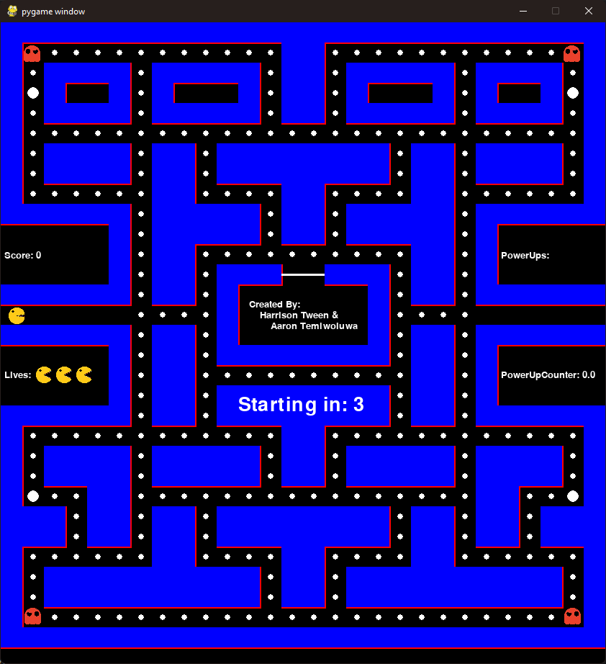
Starting the game:
The game starts out with the player (Pac-Man) on the left-hand side, and the ghosts in all 4 corners of the map.
All characters are stationary in their positions for 3 seconds before the game starts. Players cannot move until the countdown stops.
Upon the game starting, the player can move in any direction using the W, A, S, D keys.
Score is set to zero
The Power Up Counter is set to zero
Power Ups is set to zero

Slide 3
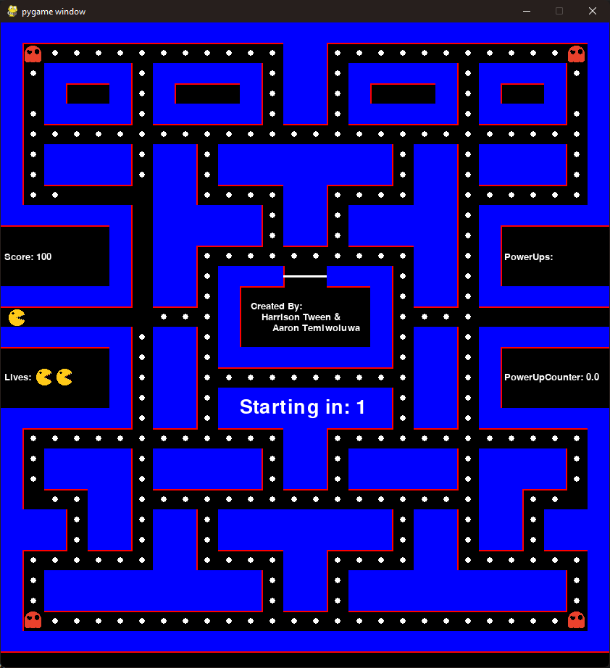
Player Respawn:
After being killed by one of the ghosts, the player will respawn, and all characters will be put back in their beginning positions, and the countdown will begin to start a new round.
After respawning, you’ll lose a life, however, the progress made before will stay the same.

Slide 4
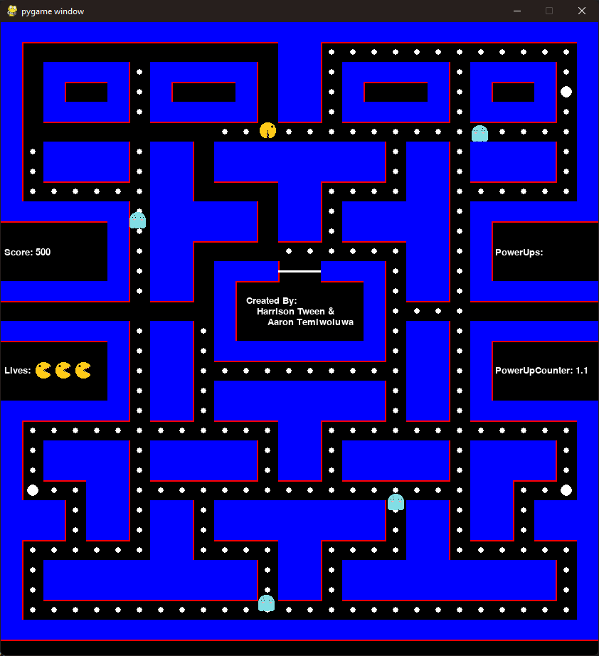
Power-Ups:
When the player takes a power up (one of the larger pellets), the player will be able to use the power up by pressing E.
Pressing E will change the movement patterns of the ghosts, as well as their colours, and now the player will be able to eat them.

Slide 5
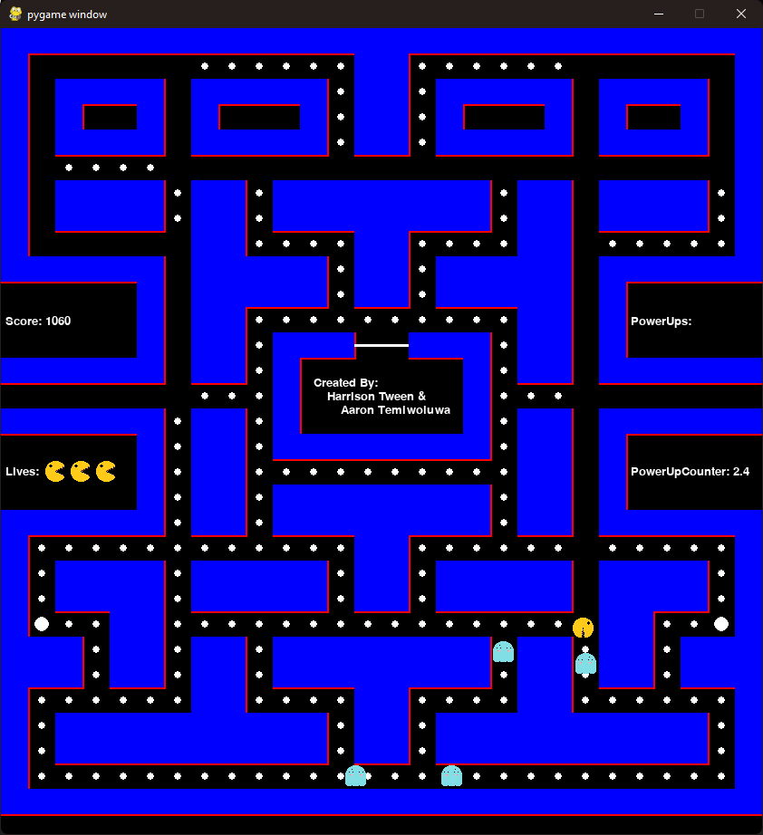
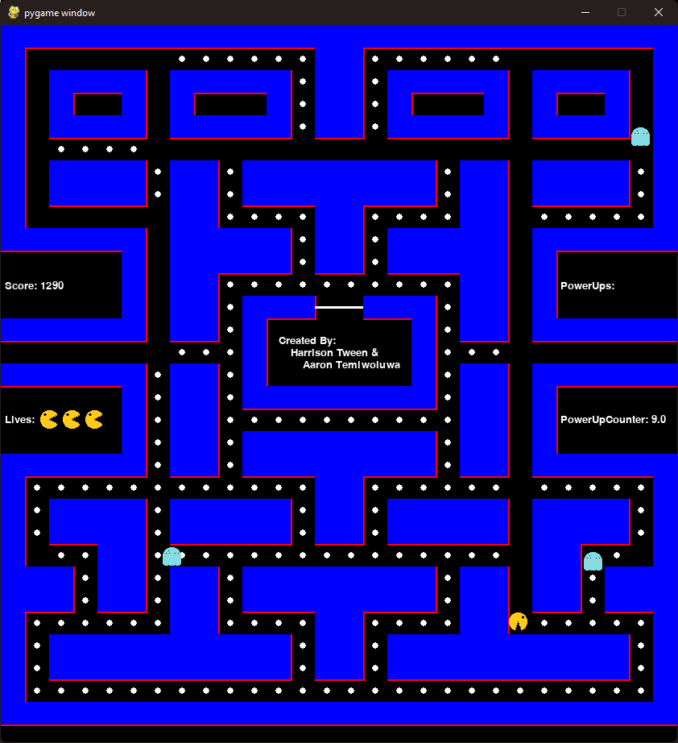
Power-Ups continued:
Player approaching the ghost (which is now vulnerable due to power up):
Player eating the ghost:

Slide 6
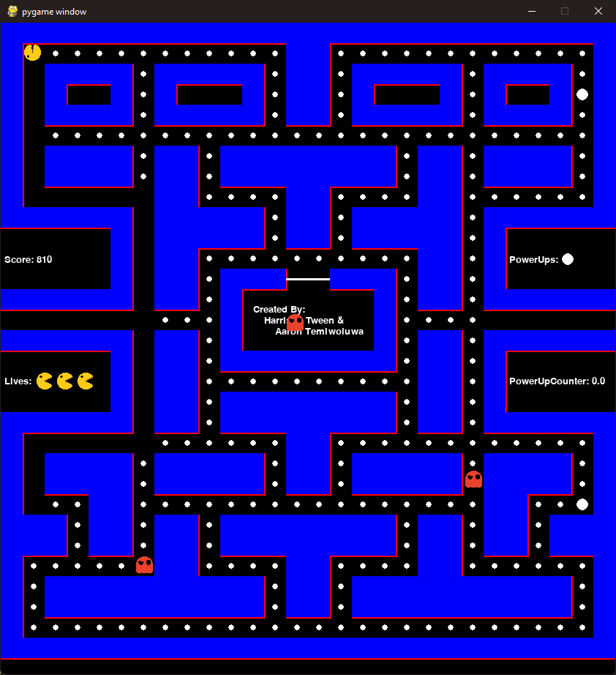
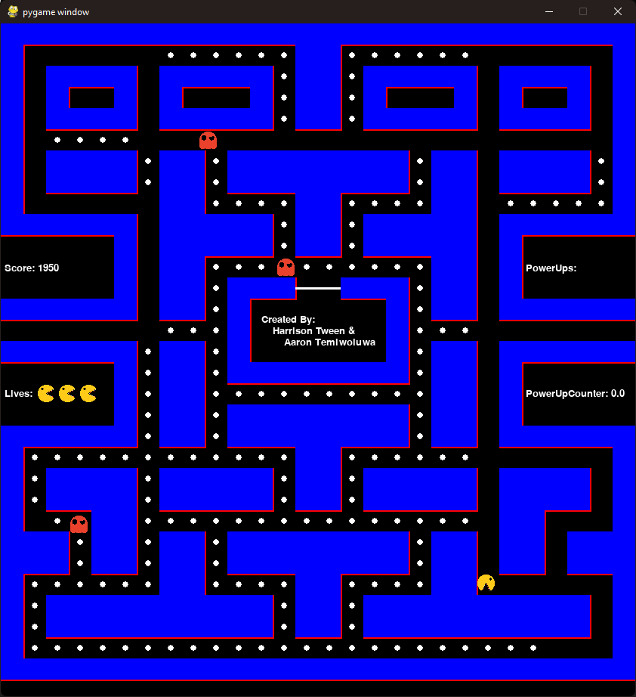
Ghost respawn:
After being eaten by the player, the ghosts will respawn in the box in the middle of the map.
The game takes note of the power-ups and adds to the counter after using one:

Slide 7
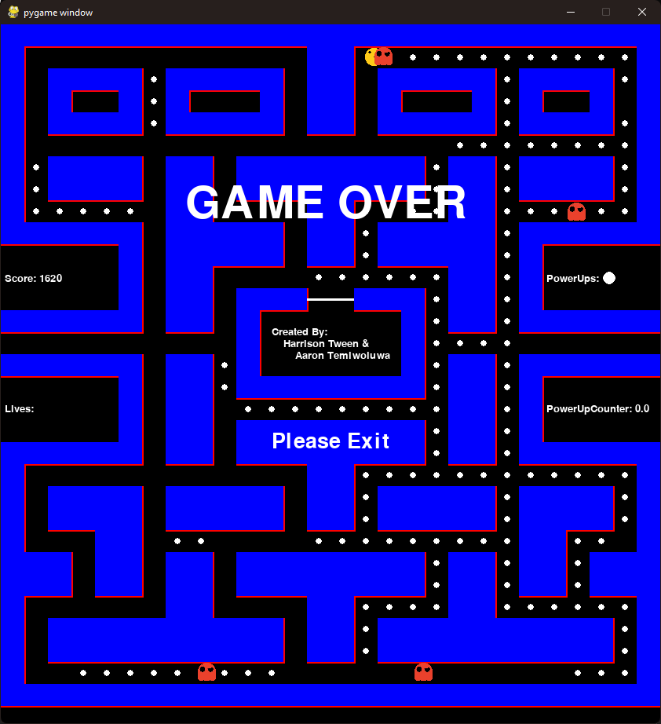
End of game:
If the player loses all of their lives, the game will end.
A large, flickering “GAME OVER” text will show on the screen, and the player will also be prompted to leave the game.
The game will be frozen until the player leaves.

